Slide 1
Document Imaging
Shared Services Imaging Services & Support

Slide 2
Document Imaging Overview
Introduction
Process Workflow
Business Services Partnership & Collaboration
Document Imaging Technology & Services
Current Environment - Projects
Challenges and Risk
Future deployment and strategy

Slide 3
Introduction
Document Imaging project mainly consists of two tools Kofax and Filenet where integration of multiple applications are there , utilized by different departments in M&T (Ex: HR, Treasury, lending, etc.) to help in fast processing and paper-less documentation which includes 21 application.
Two products namely Kofax 10.2.1 and FileNet 5.2.1are utilized in this project.
Kofax as capturing tool to export the document to Filenet
FileNet as Workflow and storage tool.
Filenet further classified in two type ICM(IBM Content Manager) and ICN(IBM Content Navigator) applications
ICM applications are workflow applications where as ICN are search and Retrieval applications

Slide 4
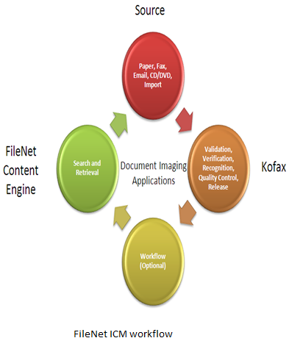
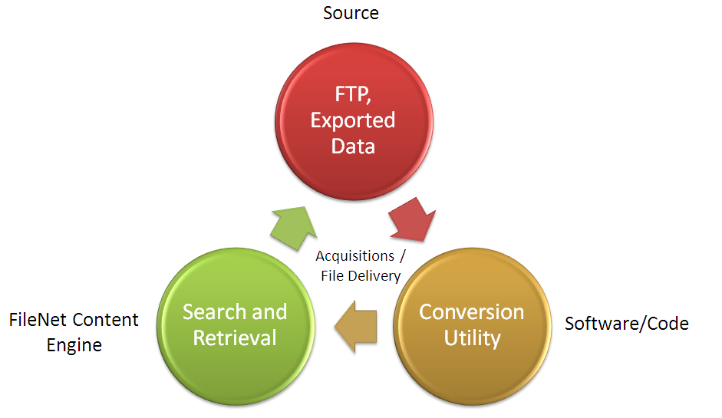
Process Workflow

Slide 5
Partnerships & Collaboration
Current Areas of Coverage
21 Production Applications:
Lending Services
COS – Commercial Closing/Collateral
COS_CIW – Commercial Imaging Workflow
COS_IPC – Indirect Post Closing
COS_RPC – Retail Post Closing
MDR – Mortgage Document Retention
MGD – Mortgage Lien Release
Consumer Lending
COS_RCL – Retail Credit and Closing
COS – Indirect Credit Lending
COS – Dealer
Human Resources
HRI – Human Resources
Commercial Cash Management
TMH – Treasury Mgmt & Agreement Housing
Central Operations
ACQ – Acquisitions
RMR – Records Management Repository
M&T Trust &Investments
TIW – Trust and Investments
M&T Securities
MTS – M&T Securities, Insurance, & Licensing
Finance
APO – Accounts Payable
Retail
BDA- Branch Document Access
Compliance
Universal Search
Wealth Document Management
WDM,ICS and SIL
Document Imaging Technology
Lending Services
Consumer Lending
Human Resources
Central Operations
Commercial Cash Management
M&T Trust and Investments
M&T Securities
Finance
Compliance
Retail

Slide 6
Benefits of Document Imaging
Expense Reduction:
Reduction in time required to create, manage and distribute content
Reduction in material costs including paper, folder, etc.
Reduction in costs associated with legal discovery
Reduction in time spent looking for lost or missing documents
Improved Efficiency:
Reduction in overhead by using automated processes and workflow
Used to help business areas identify annual benefits for their document imaging projects.
Improved Customer Service:
Immediate access to documents
Greater collaboration within and among departments
Improved Service Level Agreements (SLA’s)
Access Management:
Document control to protect customer confidentiality
Document level security
Produce immediate document-level audit trails
Legal/Regulatory:
Controlled storage for unaltered documents
Improved efficiency in storage, retention and disposition of records

